Slide 1
DIABETES
PREDICTION
BITI3123 FUZZY LOGIC
NAME | MATRIC NO
RASHMIKA A/P KATHIRAVAN | B032110121
AHNUSIYAA A/P SEKARAN | B032210015
PRASAD A/L RAGUNATHAN | B032120063

Slide 2
TABLE OF CONTENTS
01
02
INTRODUCTION
OBJECTIVE
03
04
Data preprocessing and selection of inputs
PROPOSED PREDICTIon solution
T
0

Slide 3
INTRODUCTION
Diabetes is a very common disease among individuals worldwide. This study
Uses fuzzy logic techniques to create a predictive model for diabetes prediction.
By using fuzzy logic we aim to capture the inherent medical data that leads to more reliable and accurate predictions.

Slide 4
02
objective
T
2

Slide 5
OBJECTIVES
01
03
02
To describe the classification of diverse type of dataset that can be accomplished to decide if a person is diabetic or not
Design to find and calculate the accuracy, sensitivity and specificity percentage of numerous classification methods and compare and analyze the result of several classification methods
Aim to discover solutions to detect diabetes by investigating and examining the patterns originating in the data via classification analysis

Slide 6
03
Proposed
Predictive solution
T
4

Slide 7
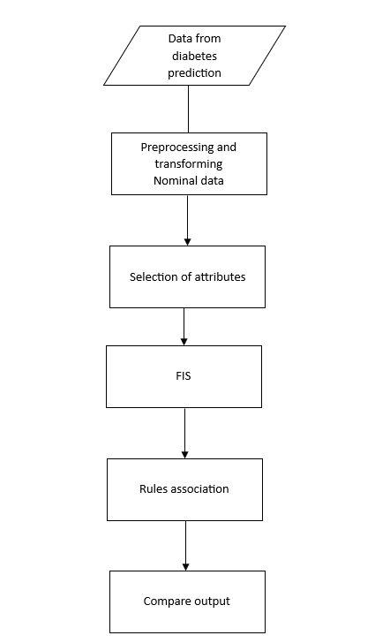
Proposed predictive solution

Slide 8
04
Data preprocessing and selection of inputs
T
4

Slide 9
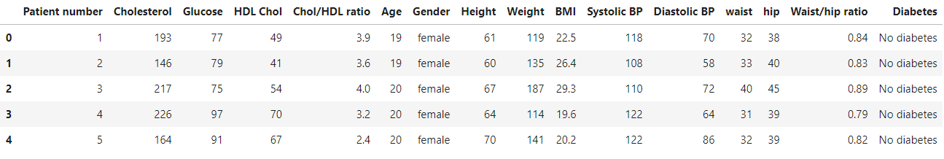
Dataset
Obtained from data.world.
Consists of 16 column and 391 samples.

Slide 10
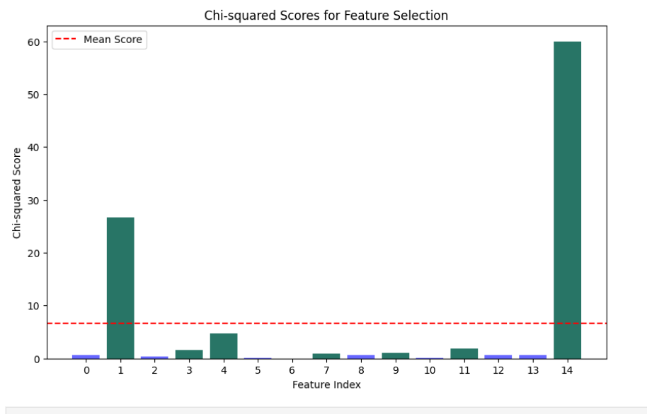
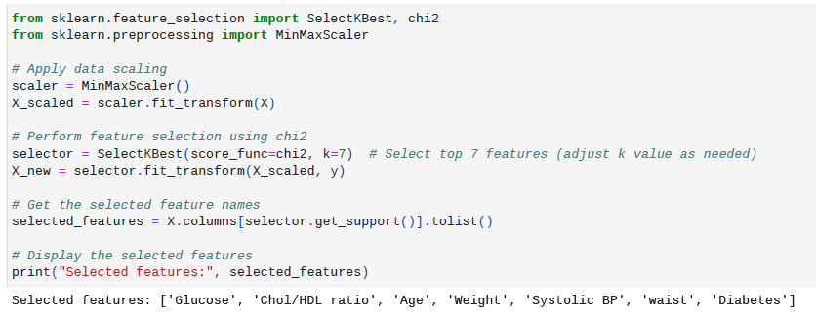
Select Best input for fis

Slide 11
06
CONCLUSIONS
T
6

